Slide 1
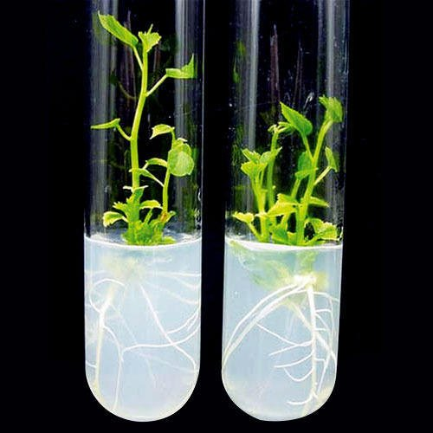
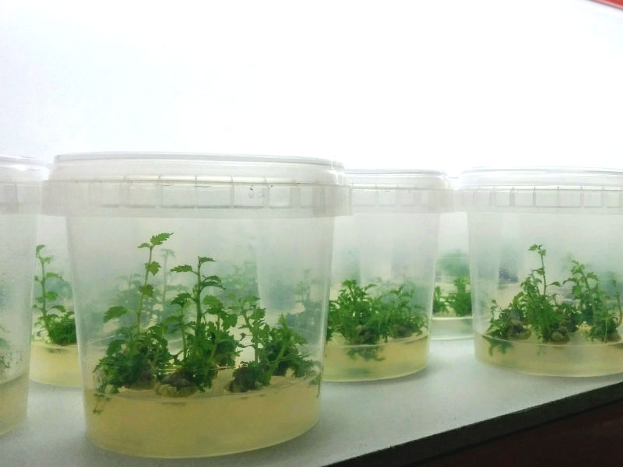
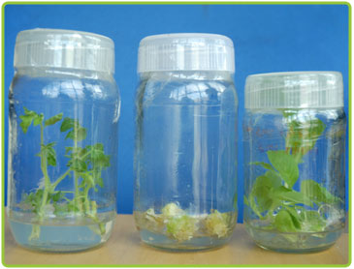
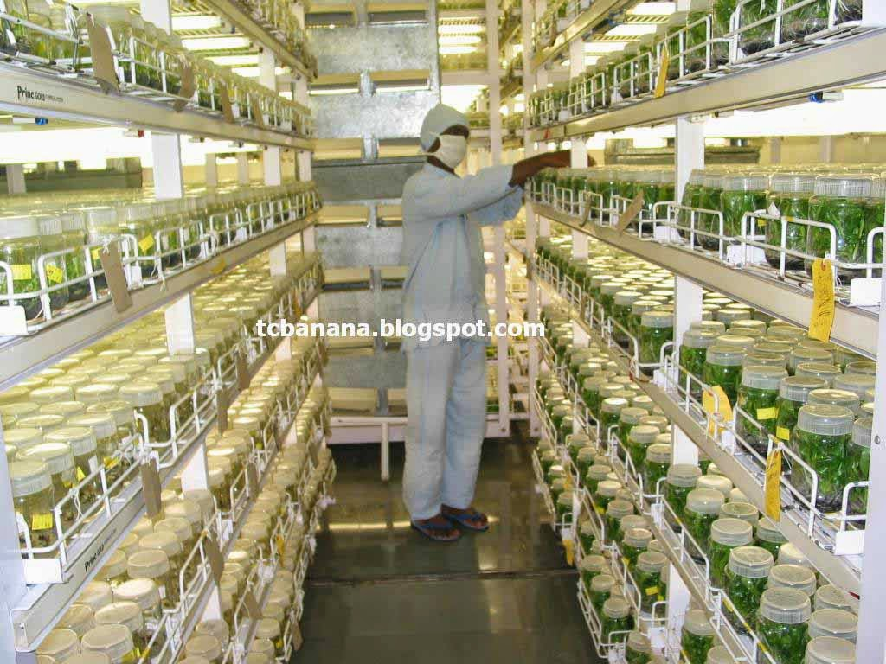
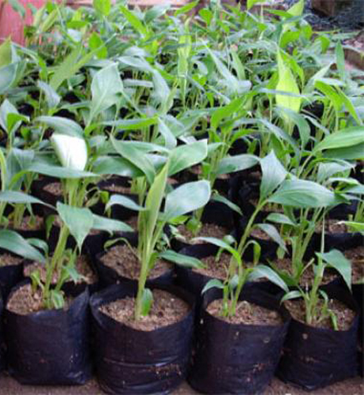
Micropropagation
Dr. Kunzes Angmo
Lecturer
Department of Biotechnology
Govt. P.G. Degree College, Rajouri

Slide 2
Introduction
Plants can be propagated by sexual or asexual means.
Clonal propagation refers to the process of asexual reproduction by multiplication of genetically identical copies of individual plants, where the term clone is used to represent a plant population derived from a single individual by asexual reproduction.

Slide 3
Invitro clonal propagation through tissue culture is referred to as micropropagation.
Micropropagation is the practice of rapidly multiplying stock plant material to produce large number of progeny plants, using modern plant tissue culture methods.

Slide 4
Stages of micropropagation
Stage 0:
Initial step in micropropagation.
Involves the selection and growth of stock plants for about 3 months under controlled conditions.
Stage I:
Initiation and establishment of culture in suitable medium.
Commonly used explants are organs, shoot tips and axillary bud.
Explant is surface sterilized before proceed for tissue culture.

Slide 5
Stage II:
Activity of micropropagation occurs in defined culture medium.
Involves multiplication of shoots or rapid embryo formation from the explant.
Stage III:
Involves the transfer of shoots to a medium for rapid development.
Sometimes shoots are directly planted in soil to develop roots.
Invitro rooting of shoot is prefered while simultaneously handling a large number of speices.

Slide 6
Stage IV:
Involves establishment of plantlets in soil.
This is done by transferring the plantlets of stage iii from the laboratory to the green house.

Slide 7
Stages of micropropagation
Stage 0
Selection of mother plant and its maintenance
Stage I
Initiation and establishment of culture
Stage II
Multiplication of shoot or rapid somatic embryo formation
Stage III
Invitro germination of somatic embryos and/or rooting of shoots
Stage IV
Transfer of plantlets to sterilized soil for hardening under green house environment

Slide 8
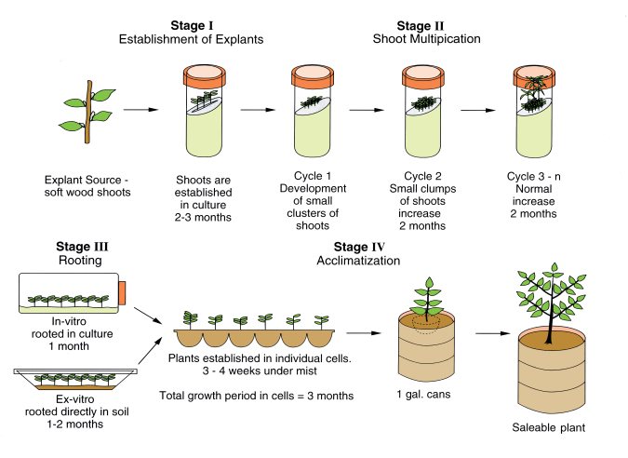
Stages involved in micropropagation

Slide 9
Approaches involved in micropropagation
Multiplication by axillary buds/apical shoots
Multiplication by adventitious shoots
Organogenesis
Somatic embryogenesis

Slide 10
Applications
1. High rate of plant propagation:
Large no of plants can be grown from single piece of plant tissue within short period.
Can be carried out throughout the year irrespective of seasonal variation.
Small sized propagules obtained in micropropagation can be easily stored for many years.
2. Production of disease free plants:
Meristem tip cultures are generally employed to develop pathogen free plants.
Successfully used for production of virus free plants of sweet potato, cassava and yam.

Slide 11
3. Production of seed in some crops:
Through axillary bud proliferation seed production can be done in some plants.
Required in certain plants where limitation for seed production is high degree of genetic conservation.
4. Cost effective process:
Requires minimum growing space.

Slide 12
Thanks

